Slide 1
ImageJ Tutorial

Slide 2
Image Manipulation and Processing
Manipulation
(1)convinient user interface
(2)provide large available functions and tools
(3)photoshop,coredraw and so on
Pocessing
(1) complex
(2)for Engineer ,programmer,scientist
(3)Matlab, ImageMagic

Slide 3
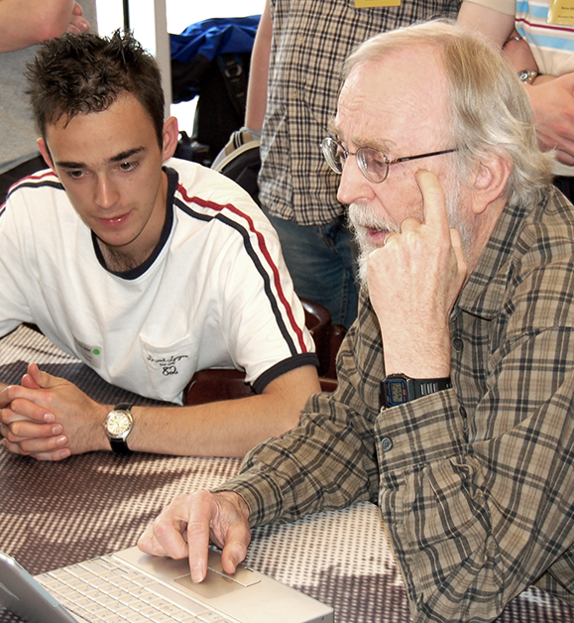
ImageJ Overview
(1) developed using Java
(2) can run on window, linux, mac
(3)wide used around the world ,particularly in biological and medical Imaging
(4) Developed by Wayne Rasband

Slide 4
Key Features
(1) A set of ready-to-use,interactive tools for creating ,visualizing ,editing,processing, analyzing,loading,and storing images.
(2)A simple plugin mechanism for extending the core functionality of ImageJ by writing pieces of Java Code.
(3)A Macro language and the corresponding interpreter.

Slide 5
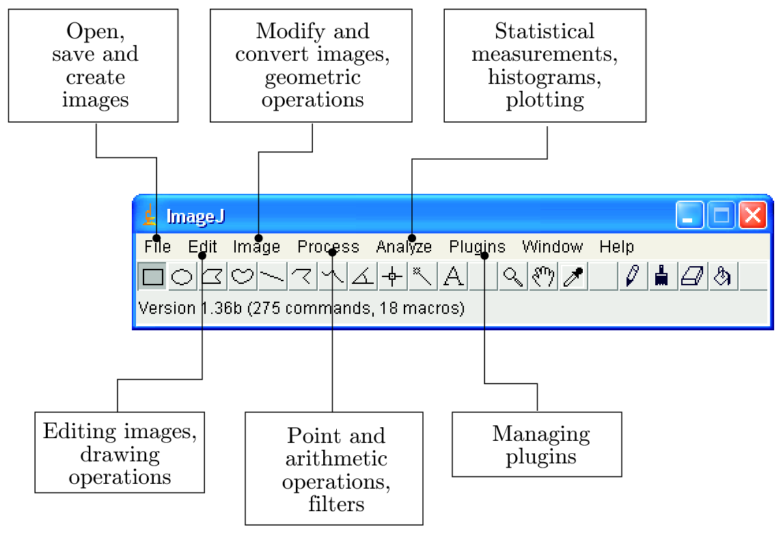
Interactive tools

Slide 6
Plugins
There are two different kinds of plugins
(1) PlugIn: require no image to be open to start a plugin
(2)PluginFilter:the currently active iamge is passed to the plugin when started
int setup(String arg,ImagePlus im)
void run(ImageProcessor ip)

Slide 7
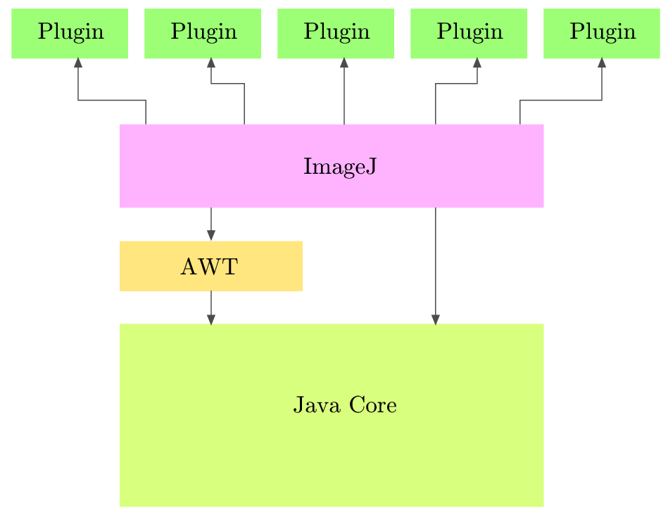
ImageJ software structure

Slide 8
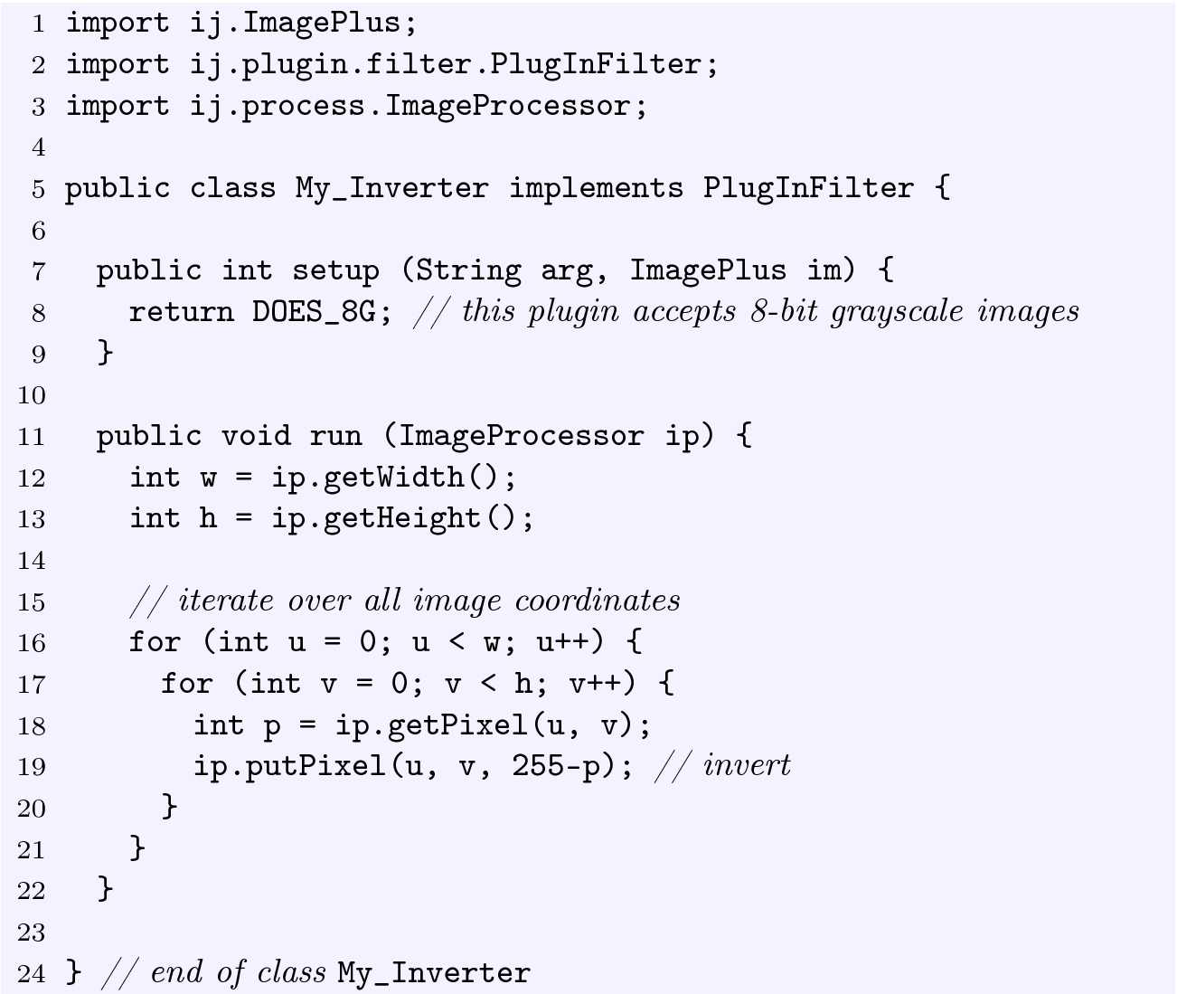
A First Example: Inverting an Image

Slide 9
The second Example:using ImageJ API
(1)Write an PlugInFilter and Implement set(String s,ImagePlus image) and run(ImageProcess ip) methods
(2)Open an Image to ImagePlus Object O
(3)New a PluginFilter pif;
(4)call pif.setup() followed pif.run()
(5)Save the result

Slide 10
Developing with Netbeans
(1)Download netbean and installation
http://www.netbeans.org/
(2)Create a new java project
(3) Add the ij.jar to the project
Code the PlugInFilter.java and main program
Compile and run it.

